Slide 1
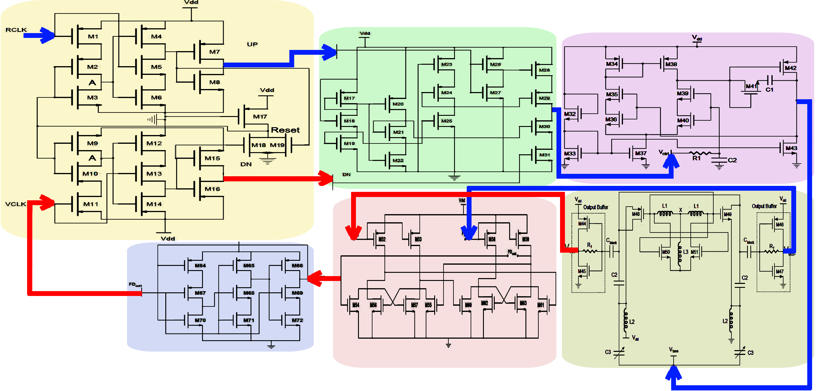
Design of 24GHz Frequency Synthesizer
¹Abrar Siddique, ¹Myeong-U Seong, and ¹Jee-Youl Ryu
abrar@pukyong.ac.kr, ryujy@pknu.ac.kr
¹Department of Information and Communication Engineering, Pukyong National University
This research describes a 24 GHz frequency synthesizer (FS) for automotive collision avoidance radar.
The voltage-controlled oscillator (VCO) is designed in modified current-reuse configuration, where transistors are biased in subthreshold region to save power consumption.
The proposed FS showed low power consumption of 3.52mWwith the supply voltage of 0.9 V.
The designed FS has a low phase noise of −116.2 dBc @1 MHz and −124.1 dBc @10 MHz.
The settling time of designed FS is 3.1ns.
The FS has very low peak-to-peak jitter noise of 3.5 ps, and very low rms jitter of 0.75 ps.
Fig.1. The proposed 24Ghz frequency Synthesizer Circuit Design
Fig.2. Close-poop PLL phase noise
Fig.3. Closed-loop spectrum
Fig.4. Dielayout
A fully integrated low-power and low-phase noise FS with operating frequency of 24-GHz for ACAR applications is presented.
The VCO achieved a FOM of −199.7 dB using current reuse and negative resistance technique.
The designed VCO has low phase noise of −104.32 dBc @1 MHz and 127.02 dBc @10 MHz.
The VCO has wide oscillator frequency range of 7.5% at the frequency range of 24–25.8 GHz.
The size of the die of designed FS is 0.776 × 0.776 mm² including pads.
※This work is supported by IDEC

